Slide 1
Digital Image Processing
Chapter # 9 A
Morphological Image Processing
Imran Siddiqi
imran.siddiqi@mcs.edu.pk
Computer Science Department
College of Telecommunication Engineering
National University of Sciences and Technology
Notes:
Good Morning! My name is Chao.
Today I like to give a topic on “Content-Based Retrieval” which so called “CBR” in multimedia systems.

Slide 2
Contents
Introduction to Morphological Image Processing
Set Theory – Recap
Structuring Element
Fit & Hit

Slide 3
Introduction
Morphology
A branch of biology which deals with the form and structure of animals and plants
Mathematical Morphology
  A tool for extracting image components that are useful in the representation and description of region shapes
  The language of mathematical morphology is Set Theory

Slide 4


Morphology: Quick Example
Image after segmentation
Image after segmentation and morphological processing

Slide 5
Introduction
Morphological image processing describes a range of image processing techniques that deal with the shape (or morphology) of objects in an image
Sets in mathematical morphology represents objects in an image. E.g. Set of all white pixels in a binary image.

Slide 6
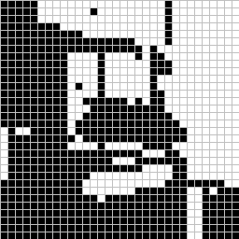
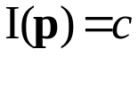

Introduction
foreground:
background
This represents a digital image. Each square is one pixel.

Slide 7
Set Theory
The set space of binary image is Z²
  Each element of the set is a 2D vector whose coordinates are the (x,y) of a black (or white, depending on the convention) pixel in the image
The set space of gray level image is Z³
  Each element of the set is a 3D vector: (x,y) and intensity level.
NOTE:
Set Theory and Logical operations are covered in:
Section 9.1, Chapter # 9, 2nd Edition DIP by Gonzalez
Section 2.6.4, Chapter # 2, 3rd Edition DIP by Gonzalez

Slide 8


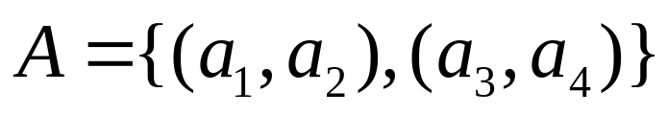

Set Theory
Let A be a set in Z². if a = (a₁,a₂) is an element of A, then we write
If a is not an element of A, we write
Set representation
Empty or Null set

Slide 9



Set Theory
Subset: if every element of A is also an element of another set B, the A is said to be a subset of B
Union: The set of all elements belonging either to A, B or both
Intersection: The set of all elements belonging to both A and B

Slide 10



Set Theory
Two sets A and B are said to be disjoint or mutually exclusive if they have no common element
Complement: The set of elements not contained in A
Difference of two sets A and B, denoted by A – B, is defined as
i.e. the set of elements that belong to A, but not to B

Slide 11
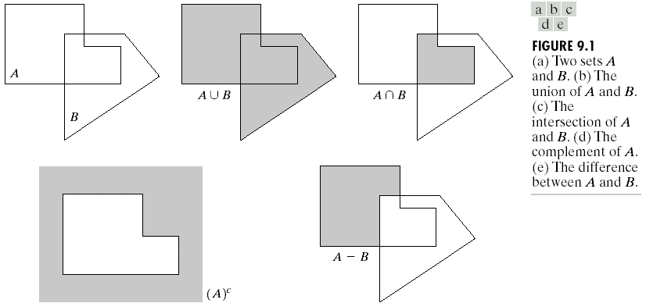
Set Theory

Slide 12
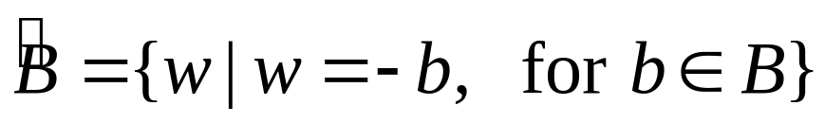
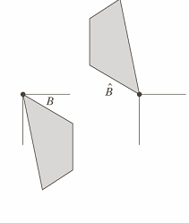
Set Theory
Reflection of set B
i.e. the set of element w, such that w is formed by multiplying each of two
coordinates of all the elements of set B by -1

Slide 13

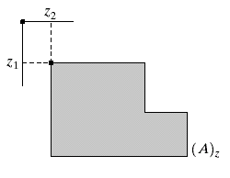
Set Theory
Translation of set A by point z = (z₁,z₂), denoted (A)_{z}, is defined as

Slide 14
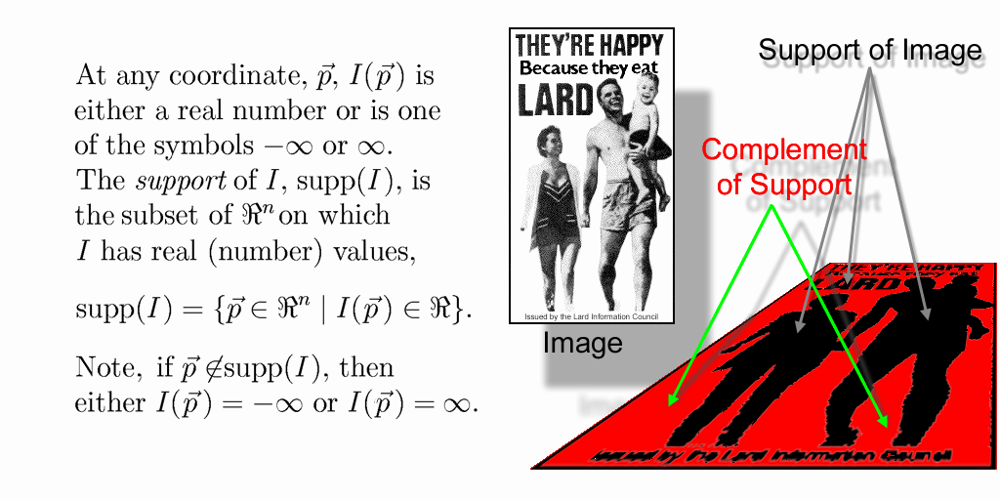


Support of an Image
The support of a binary image, I, is
That is, the support of a binary image is the set of foreground pixel locations within the image plane.
The complement of the support is, therefore, the set of background pixel locations within the image plane.

Slide 15
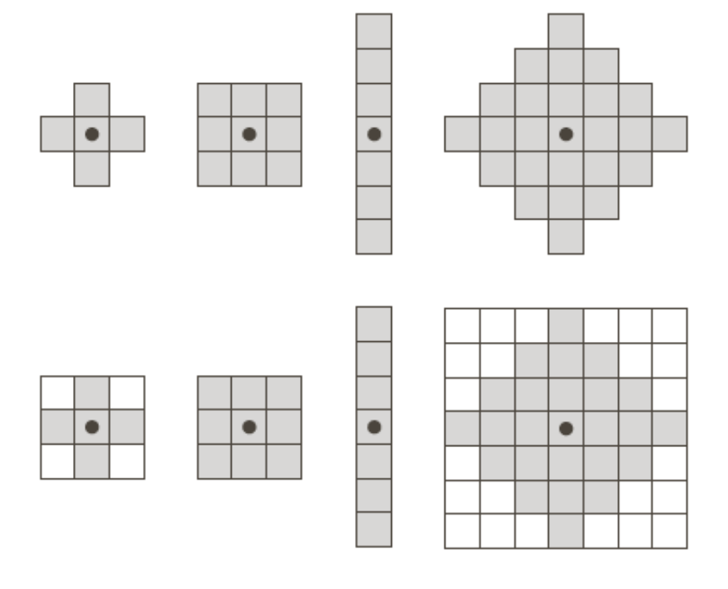
Structuring Element
A structuring element is a small image – used as a moving window
Example Structuring Elements
Structuring Elements converted to rectangular arrays

Slide 16
Structuring Element
For simplicity we will use rectangular structuring elements with their origin at the middle pixel
0 | 0 | 1 | 0 | 0
0 | 1 | 1 | 1 | 0
1 | 1 | 1 | 1 | 1
0 | 1 | 1 | 1 | 0
0 | 0 | 1 | 0 | 0
1 | 1 | 1
1 | 1 | 1
1 | 1 | 1
0 | 1 | 0
1 | 1 | 1
0 | 1 | 0

Slide 17


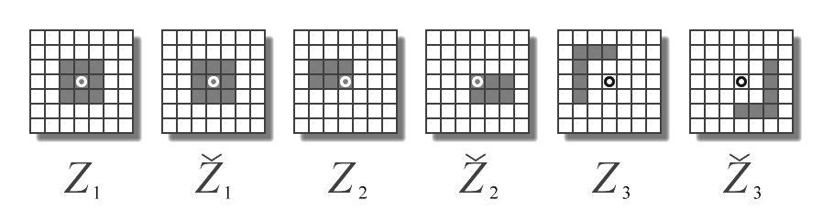


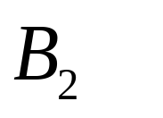
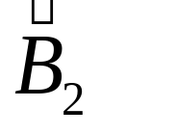
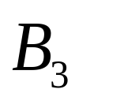
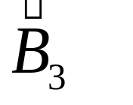
Structuring Element: Reflection
rotated by 180º around its origin.

Slide 18
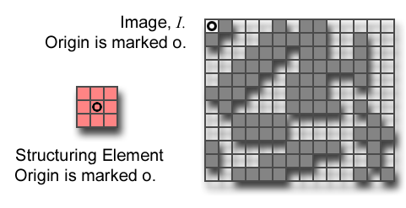
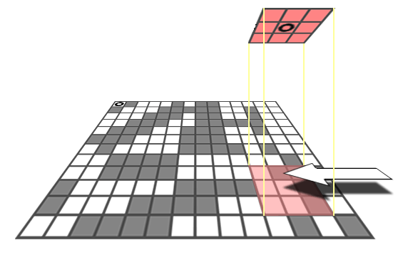
Structuring Element: Translation
Let I be an image and B a SE.
(B)_{z} means that B is moved so that its origin coincides with location z in S_{P}.
(B)_{z} is the translate of B to location z in S_{P}.
B
z=(z₁,z₂)

Slide 19
Structuring Elements: Hits & Fits
B
Structuring Element
Fit: All on pixels in the structuring element cover on pixels in the image
Hit: Any on pixel in the structuring element covers an on pixel in the image
A
C
All morphological processing operations are based on these simple ideas

Slide 20
Fitting & Hitting
0 | 0 | 0 | 0 | 0 | 0 | 0 | 0 | 0 | 0 | 0 | 0
0 | 0 | 0 | 1 | 1 | 0 | 0 | 0 | 0 | 0 | 0 | 0
0 | 0 | 1 | 1 | 1 | 1 | 1 | 0 | 0 | 0 | 0 | 0
0 | 1 | 1 | 1 | 1 | 1 | 1 | 1 | 0 | 0 | 0 | 0
0 | 1 | 1 | 1 | 1 | 1 | 1 | 1 | 0 | 0 | 0 | 0
0 | 0 | 1 | 1 | 1 | 1 | 1 | 1 | 0 | 0 | 0 | 0
0 | 0 | 1 | 1 | 1 | 1 | 1 | 1 | 1 | 0 | 0 | 0
0 | 0 | 1 | 1 | 1 | 1 | 1 | 1 | 1 | 1 | 1 | 0
0 | 0 | 0 | 0 | 0 | 1 | 1 | 1 | 1 | 1 | 1 | 0
0 | 0 | 0 | 0 | 0 | 0 | 0 | 0 | 0 | 0 | 0 | 0
1 | 1 | 1
1 | 1 | 1
1 | 1 | 1
B
C
Structuring Element 1
0 | 1 | 0
1 | 1 | 1
0 | 1 | 0
A
Structuring Element 2

Slide 21
Acknowledgements
Digital Image Processing”, Rafael C. Gonzalez & Richard E. Woods, Addison-Wesley, 2002
Peters, Richard Alan, II, Lectures on Image Processing, Vanderbilt University, Nashville, TN, April 2008
Brian Mac Namee, Digitial Image Processing, School of Computing, Dublin Institute of Technology
Computer Vision for Computer Graphics, Mark Borg
Material in these slides has been taken from, the following resources

